Slide 1
Customer Segmentation Analysis
Pushpanjali Gupta
Team ID: PTID-CDA-DEC-23-087

Slide 2
Dataset
Shopping information from 10 different shopping malls between 2021 & 2023 in Istanbul.
Includes essential information such as
- Invoice numbers
- Customer IDs
- Age
- Gender
- Payment methods
- Product categories
- Quantity
- Price
- Order dates and
- Shopping mall locations

Slide 3
Problem Statement
m
1
Visualize the data using Tableau /Power BI
2
Derive insights
3
Give your inputs/suggestions to the company

Slide 4
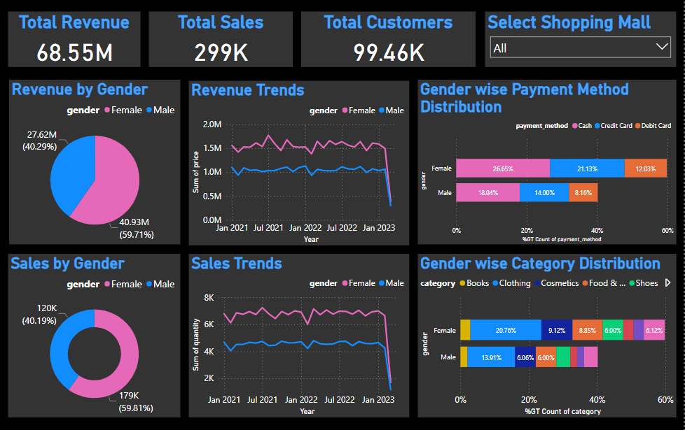
Shopping Distribution by Gender

Slide 5
Insights
Total revenue generated from female customers is more than that of from male customers.
Total sales is more from female customers as compared to male customers.
Revenue and Sales for both male and female customers follow similar trend.
Revenue and Sales over all the time period is more for female customers as compared to male customers.
Cash is the preferred mode of payment for both the genders.
Maximum shopping is done in Clothing category in case of both the genders.

Slide 6
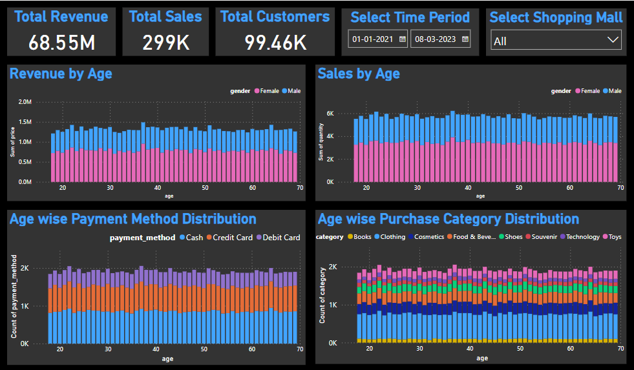
Shopping Distribution by Age

Slide 7
Insights
Age wise revenue and sales more from female customers.
Revenue and sales for each age group almost same.
Customers of age 22, 37, 51 & 64 crossed 1.4 mn revenue mark.
Customers of age 22, 37, 51 & 64 crossed almost 6K sales quantity mark.
Highest revenue(1.5 mn) & highest sales (6217) from customers of age group 37.
Cash is the most preferred mode of payment for customers of all the ages.
Maximum shopping done in clothing category by customers of all the ages.

Slide 8
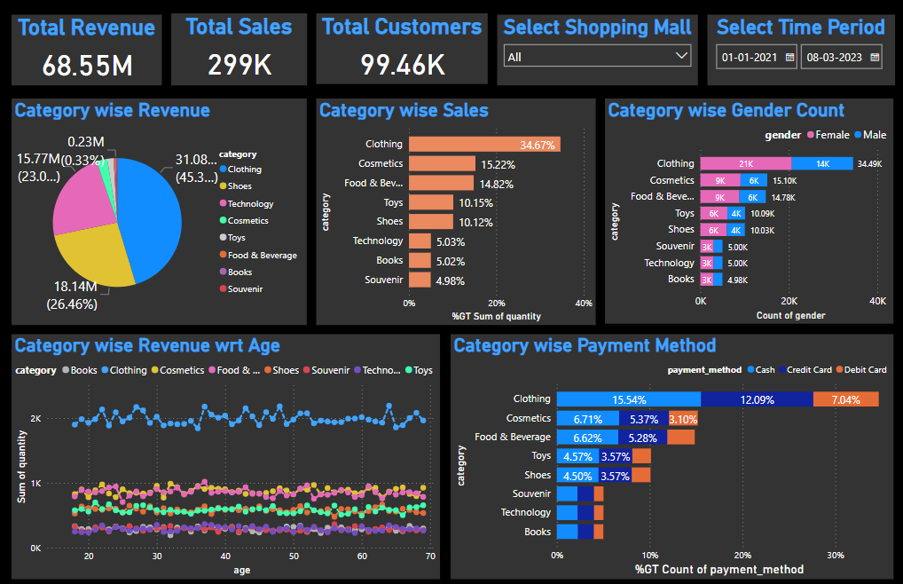
Distribution of Purchase Category

Slide 9
Insights
Clothing has the highest share in the revenue (~45%).
~95% revenue comes from clothing, shoes and technology.
Clothing alone has ~1/3rd (35%) share in sales, followed by Cosmetics, food & beverages.
Across all the categories, female customers are more in number compared to male customers.
Clothing is the most purchased category across all the ages.
Cash is the most widely used payment method for all the categories.

Slide 10
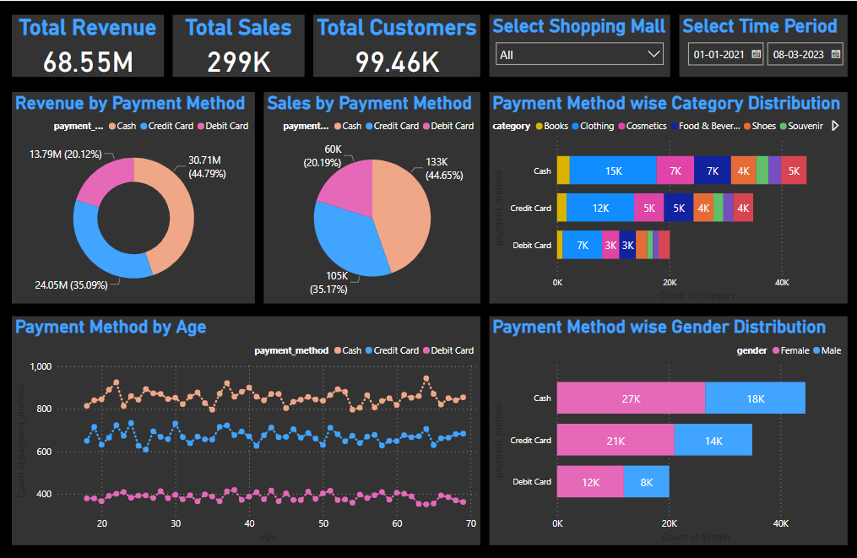
Distribution of Payment Method

Slide 11
Insights
Maximum revenue and sales is from cash followed by credit and debit payment methods.
By each of the payment method, clothing category is shopped the most. Followed by Cosmetics and Food & Beverage.
Across all the ages, cash is the most preferred mode of payment followed by credit & debit.
In each payment method, female customers are 1.5 times that of male customers.

Slide 12
Suggestions
To further growth in terms of revenue and sales, clothing category could be targeted more by focusing on variety, designs & economy of scale etc.
To increase revenue from male customers, categories like shoes, technology, books etc. could be targeted more.
Young population are generally a valuable group of consumers, which could be targeted by focusing their demands and needs.
To increase the digital payment, certain incentives could be provided on card payment options.

Slide 13
THANK YOU

